Slide 1

JCCM MEMBERS MANAGEMENT SYSTEM

Slide 2
Why do we need this system?
To easily track the growth of church in terms of quantity and quality.

Slide 3
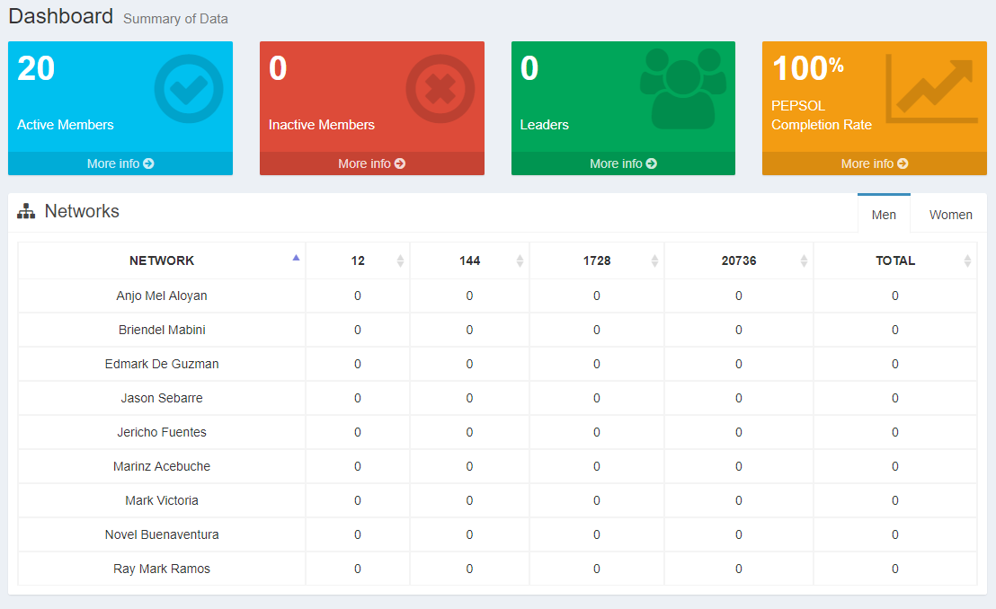
What are the features?
Dashboard

Slide 4
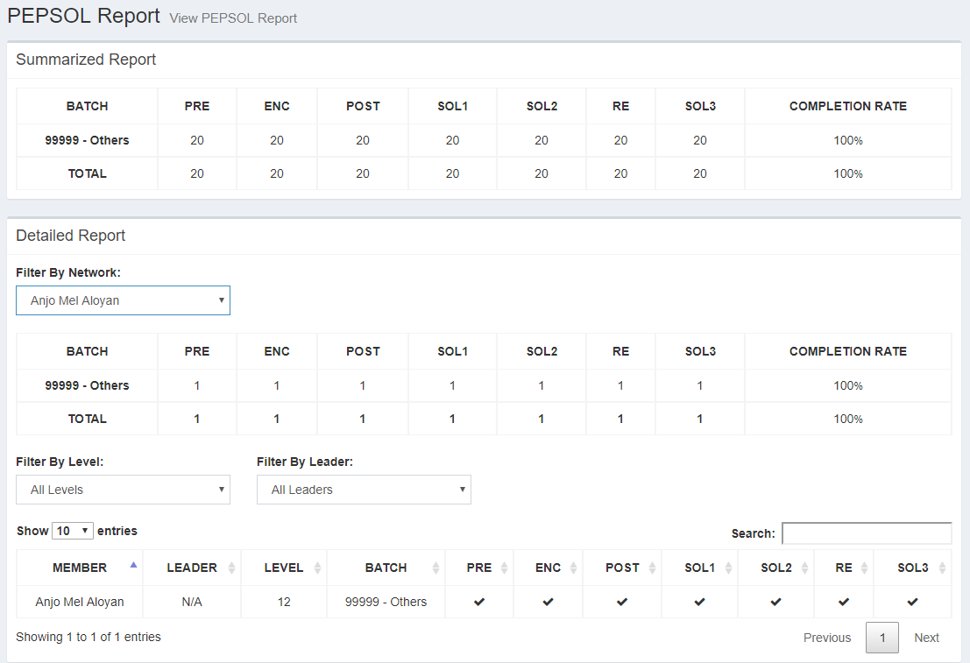
What are the features?
PEPSOL Report

Slide 5
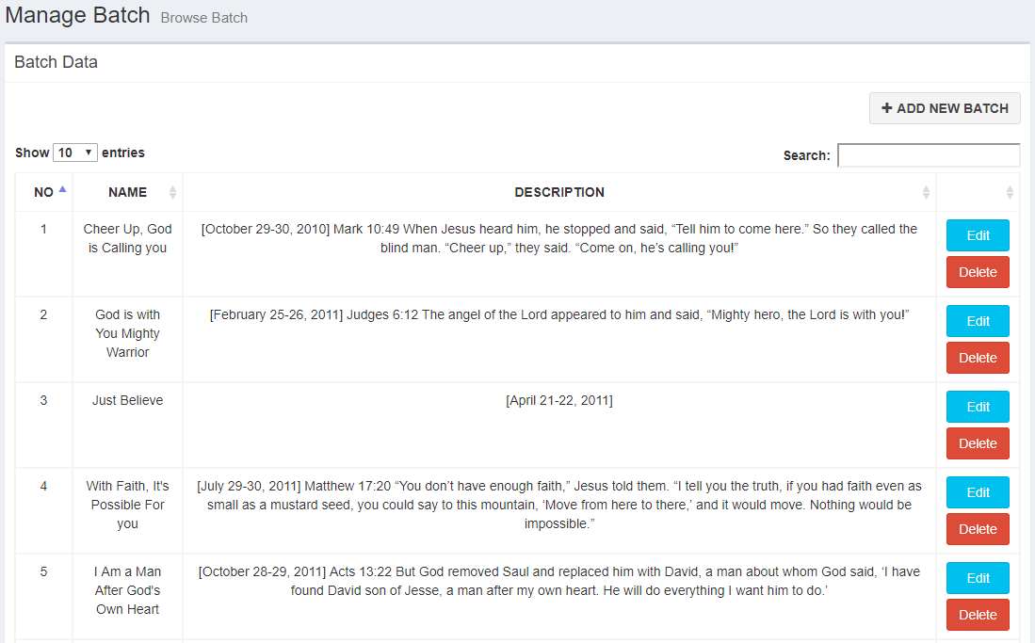
What are the features?
Batch Management

Slide 6





Network
Representative
4
Generate Report
3
1
Approve Request
2
Send Request Form
(Add or Update Member)
Member
Profile
Admin

Slide 7
Steps on how to
create a request

Slide 8
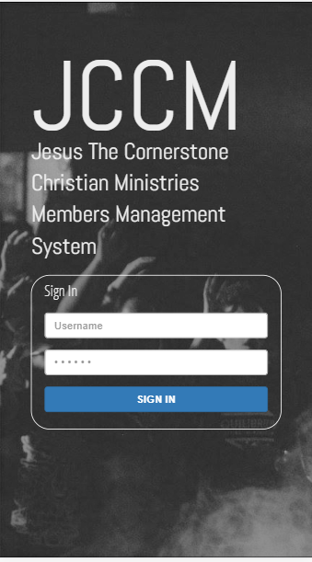
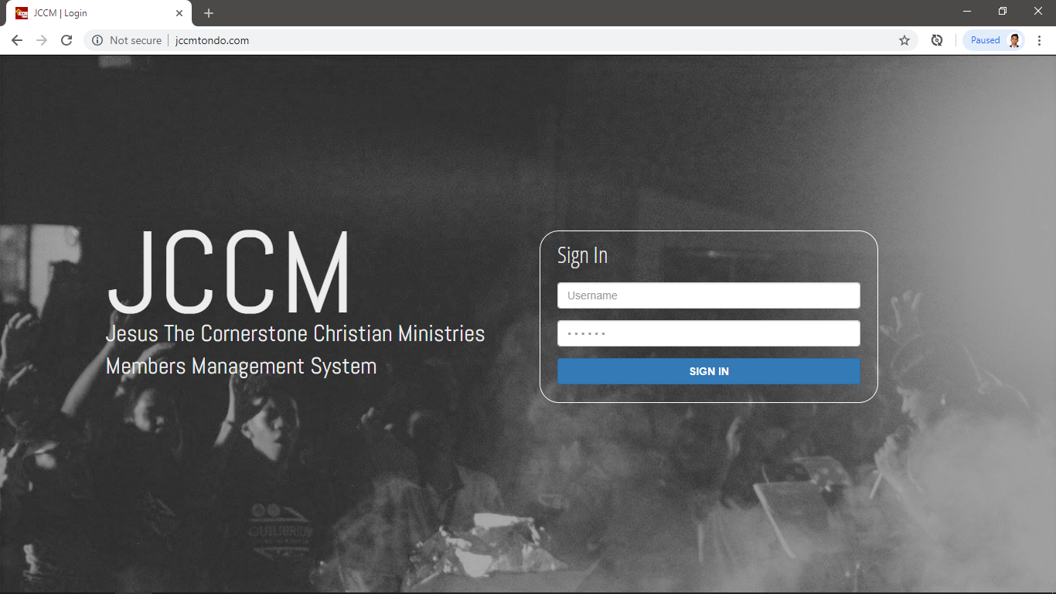
Go to jccmtondo.com and sign in using your account. A username and temporary password will be given to you.
Steps on how to
create a request

Slide 9
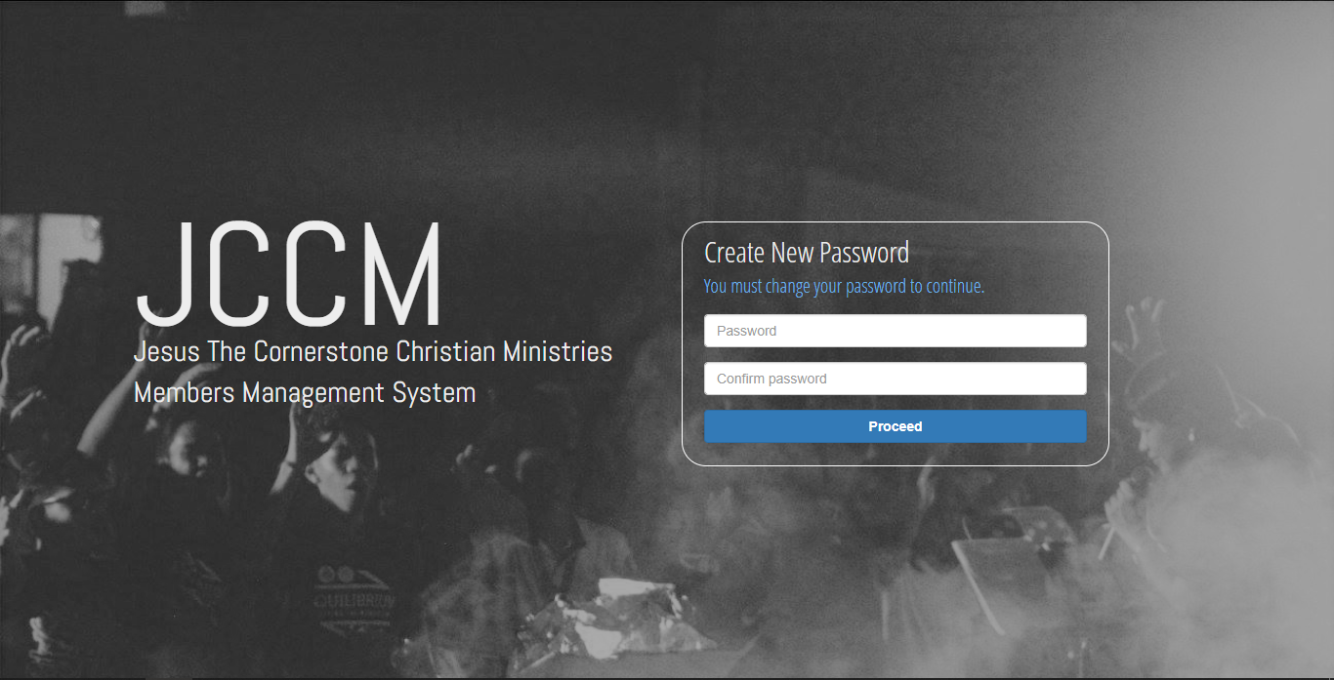
On your first login you must change your password to proceed.
Steps on how to
create a request

Slide 10
On your first login you must change your password to proceed.
Steps on how to
create a request

Slide 11
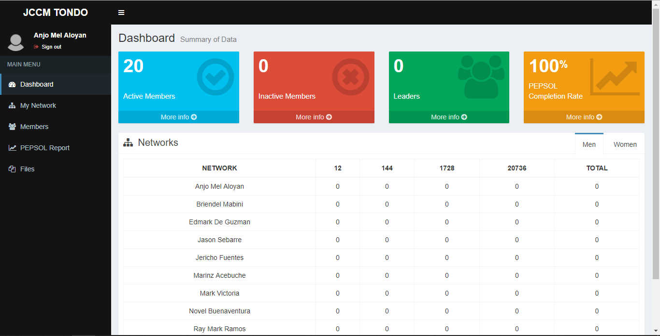
Go to My Network
Steps on how to
create a request

Slide 12
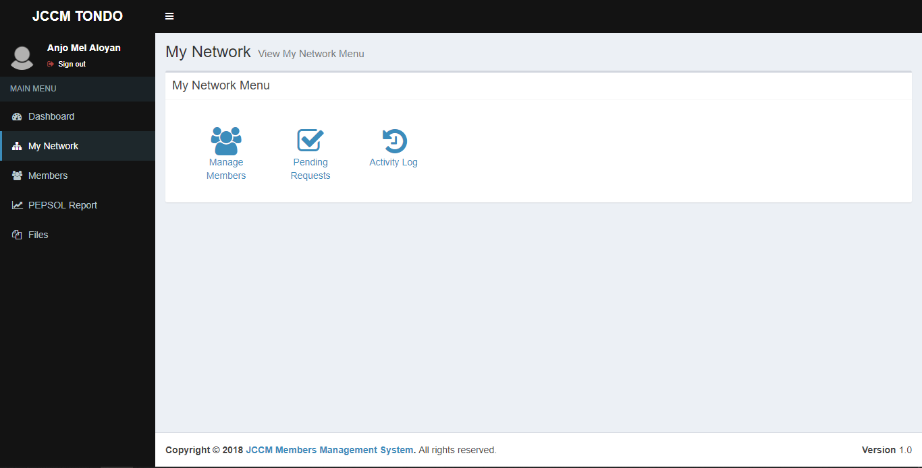
Click on Manage Members
Steps on how to
create a request

Slide 13
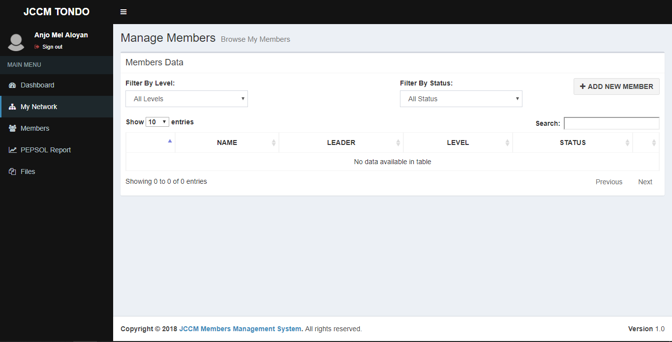
Click Add New Member
Steps on how to
create a request

Slide 14
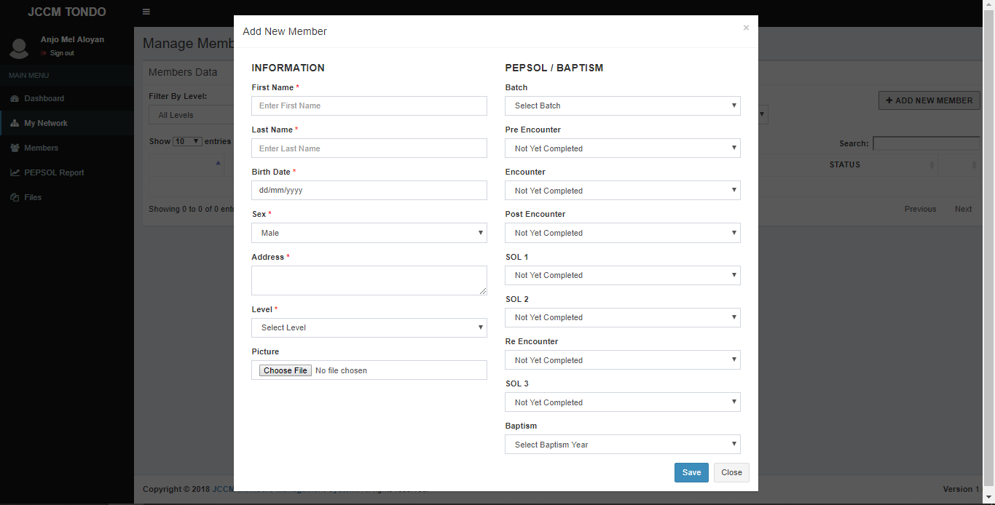
Click save after completing the form
Steps on how to
create a request

